Slide 1
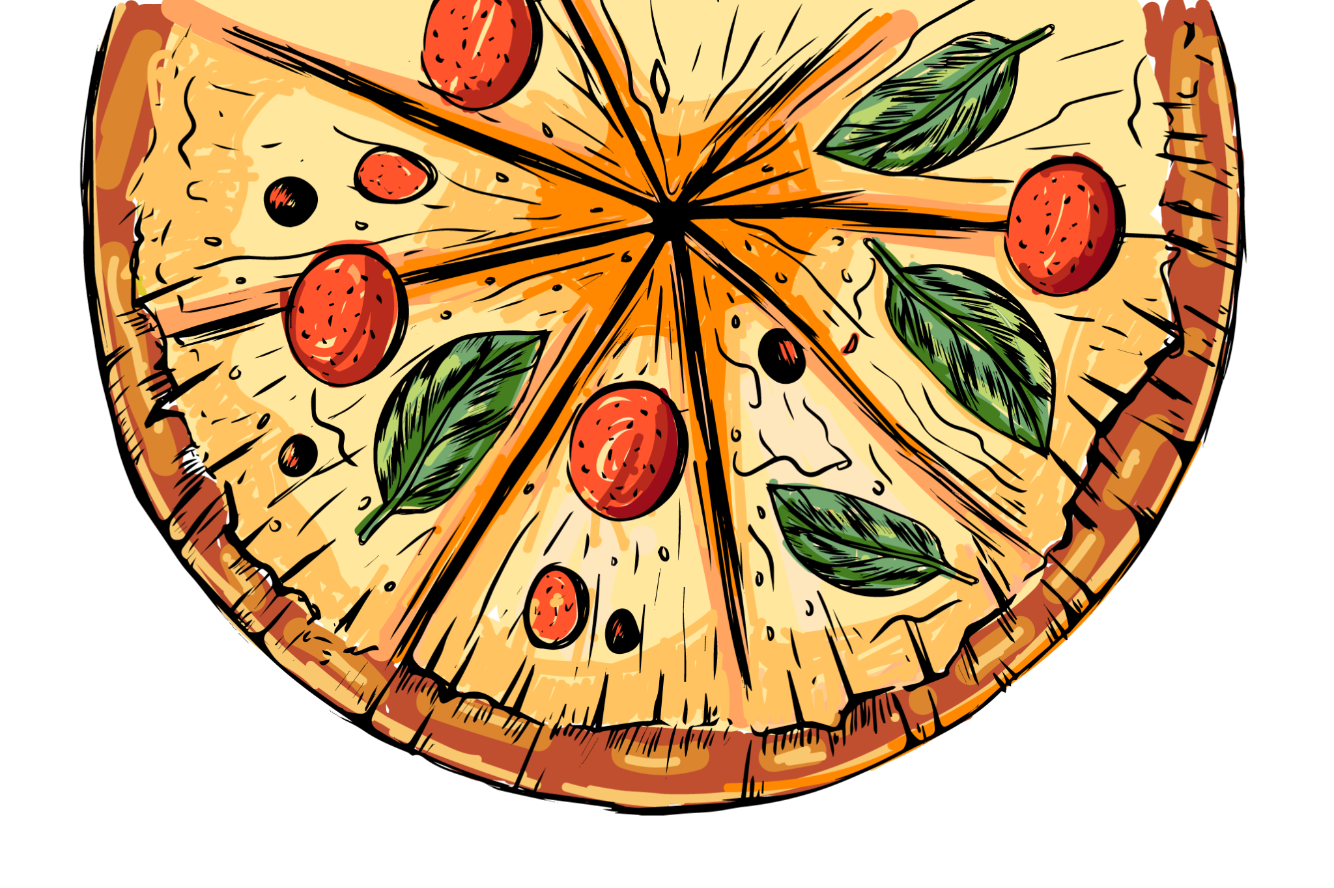
PIZZA SALES ANALYSIS
www.slidesgo.es
FOR MENTORNESS
By Krishnakoli Datta

Slide 2


INTRODUCTION
This project focuses on analyzing sales data from a pizzeria.
The analysis aims to demonstrate data manipulation skills, effective visualization techniques, and the ability to derive meaningful insights from real-world-like datasets.
The project explores various aspects of the pizza business, including sales trends, popular products, and pricing strategies. The insights gained will illustrate how data analysis can inform business decisions and improve operations in the food service industry.

Slide 3

CONTENTS OF THE PRESENTATION
ORDER ANALYSIS
PRODUCT PERFORMANCE
CATEGORY OVERVIEW
BUSINESS PROBLEM
REVENUE INSIGHTS
PRICING STRATEGY
INSIGHTS AND RECOMMENDATIONS

Slide 4
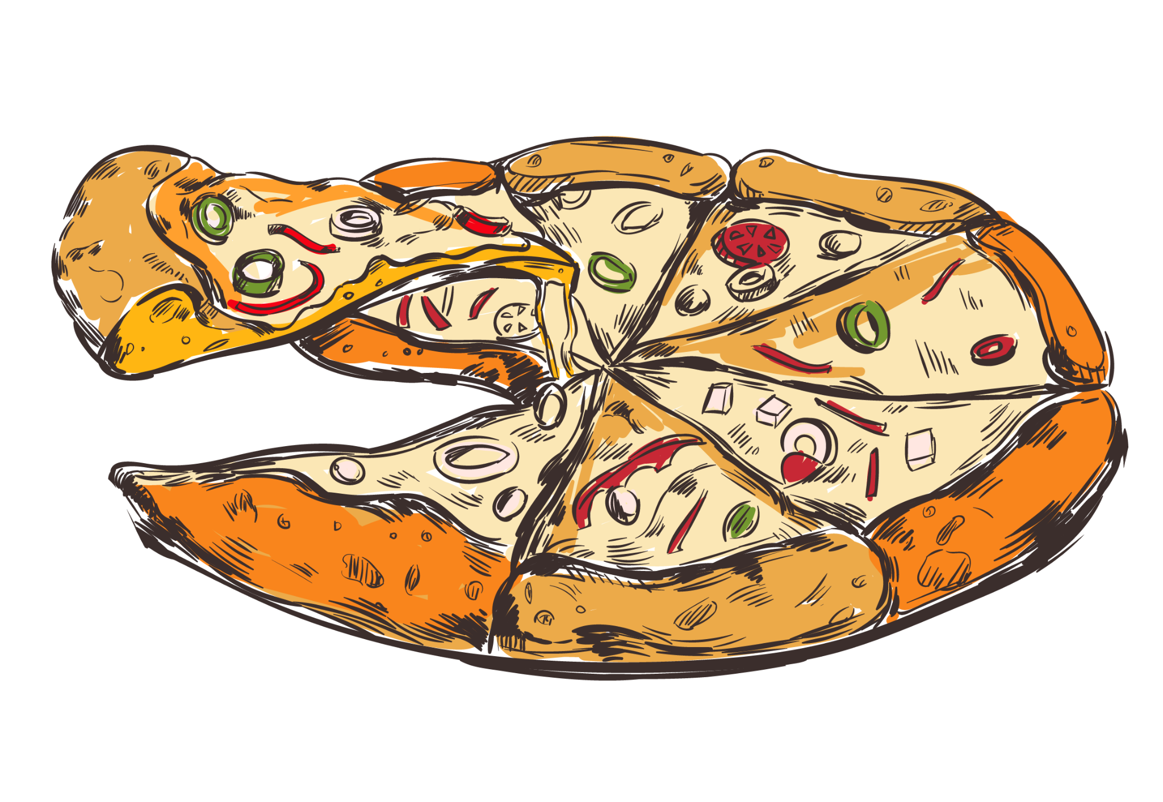
BUSINESS QUESTIONS
Order Analysis | Revenue Insights
What is the total number of orders? How do average orders vary by day of the week? What are the peak ordering hours? | What is the total revenue from pizza sales? How does the monthly revenue trend look?
Product Performance | Category Overview
What are the top pizza types by quantity sold? Which pizza sizes are most popular? What are the top 3 revenue-generating pizzas for each category? | How many pizza types do we offer in each category? What is the order quantity for each category? How much revenue is generated by each category?
Pricing Strategy
What is the highest-priced pizza? What is the price range for each pizza category?

Slide 5


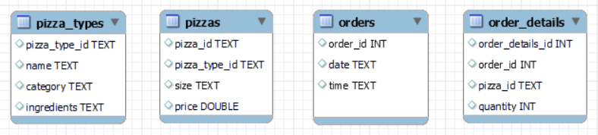
ABOUT THE DATASET
01
02
03
04

Slide 6
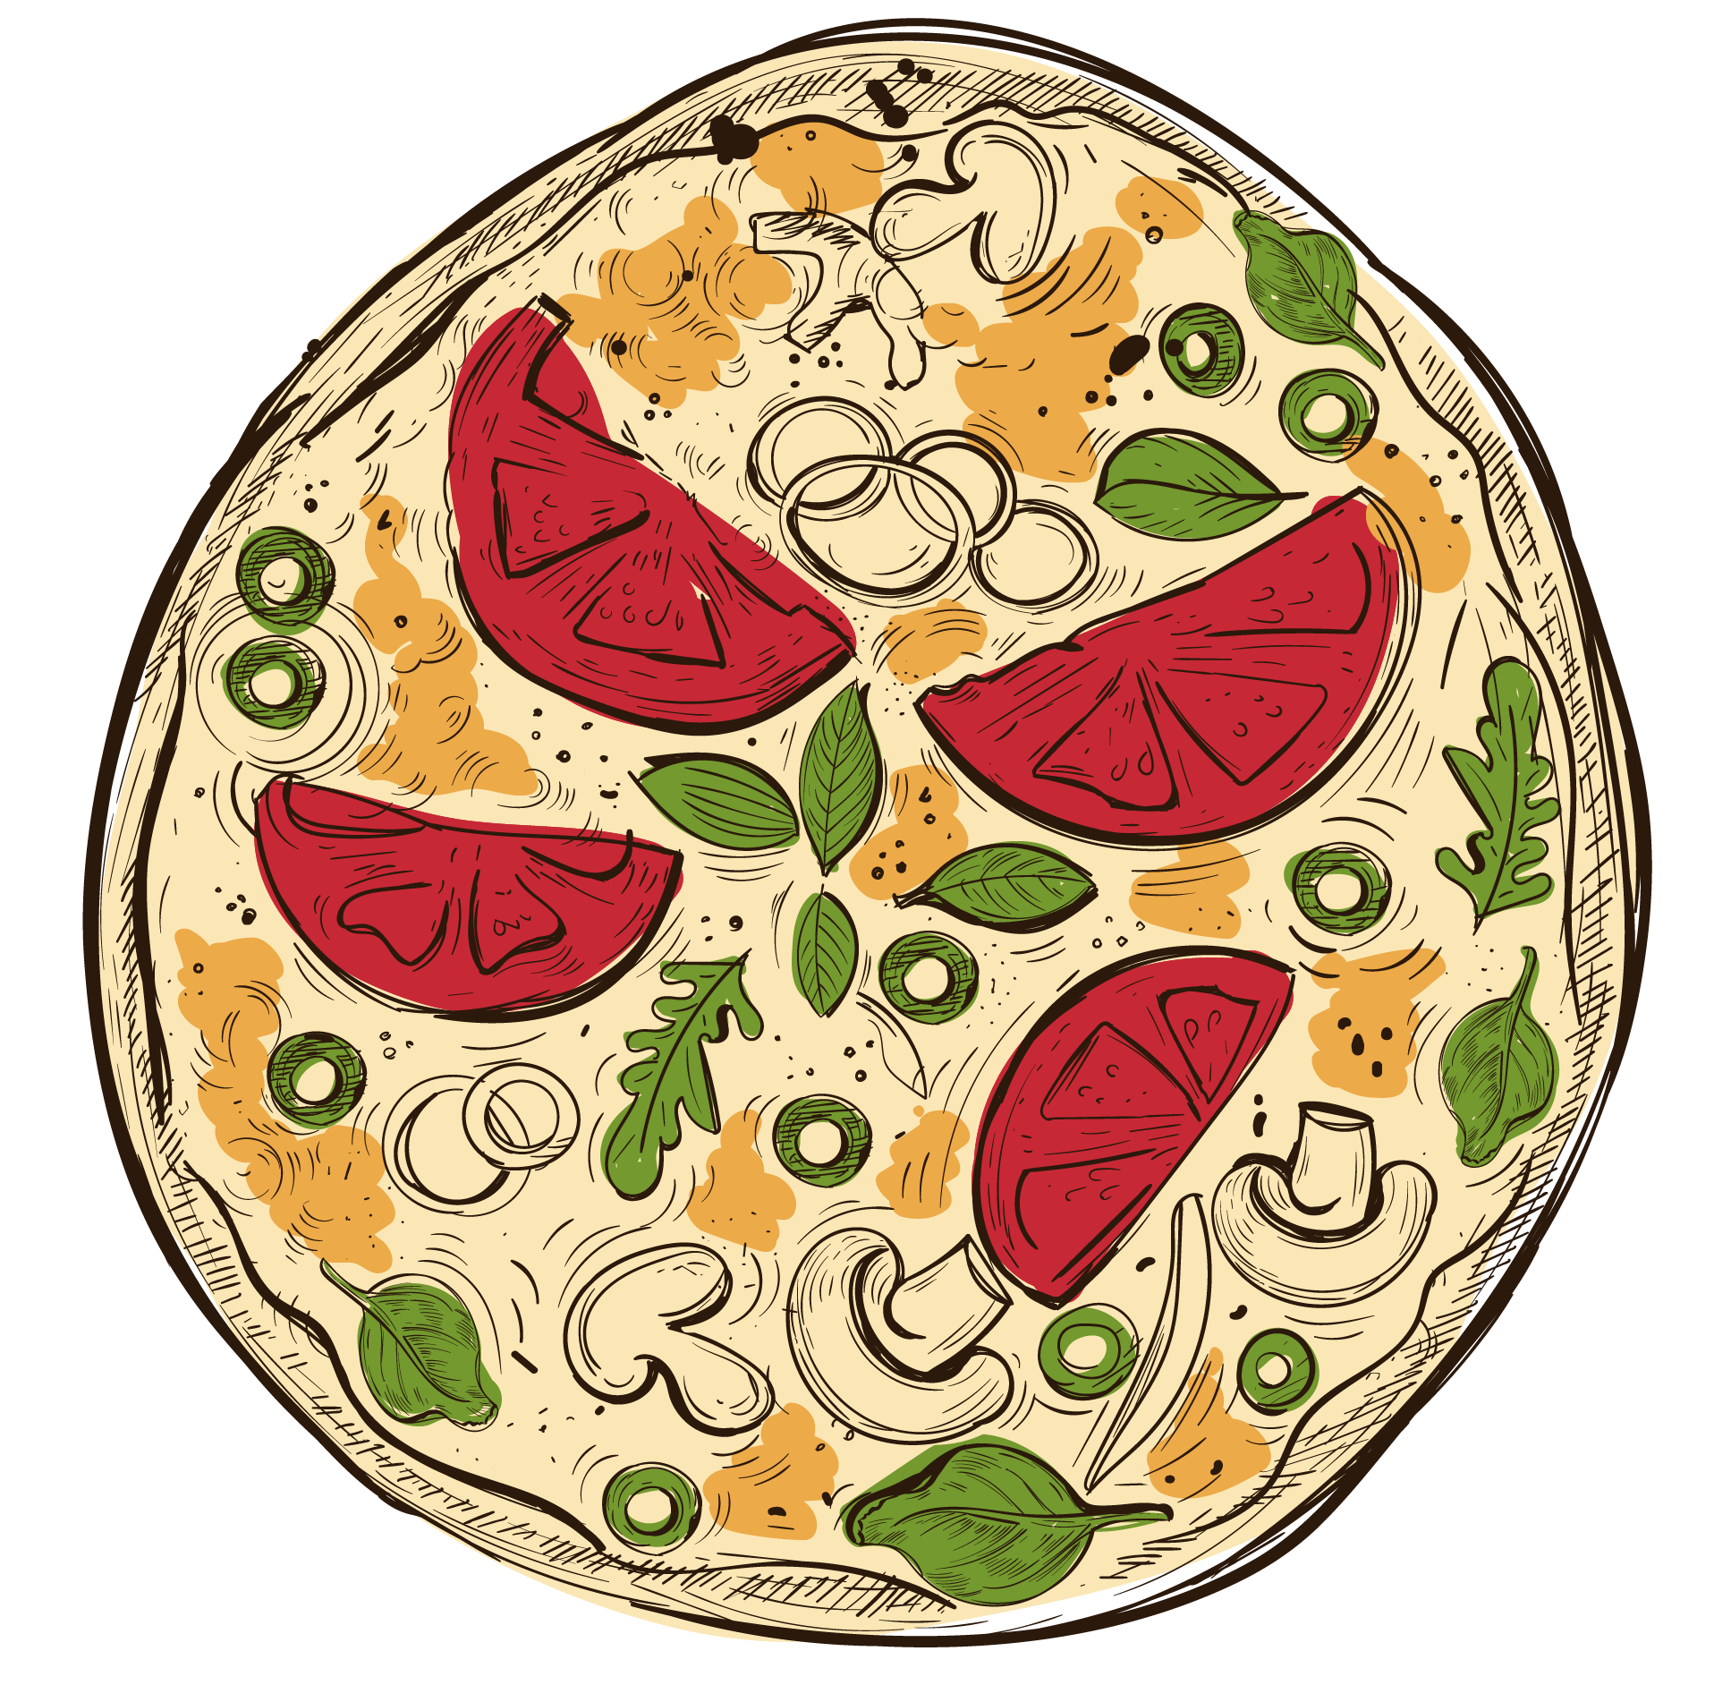

01
ORDER ANALYSIS
Understanding Sales Patterns

Slide 7
48,620
Total Orders
SELECT COUNT(distinct order_details_id) AS total_orders FROM order_details;

Slide 8
ORDER VOLUME AND DAILY TRENDS
Busiest Day
WITH day_names AS (
SELECT 1 AS day_num, 'Sunday' AS day_name UNION SELECT 2, 'Monday’ UNION SELECT 3, 'Tuesday’ UNION SELECT 4, 'Wednesday’ UNION SELECT 5, 'Thursday’ UNION SELECT 6, 'Friday’
UNION SELECT 7, 'Saturday’ ) SELECT dn.day_num, dn.day_name, round(AVG(daily_orders.orders_per_day),0) AS avg_orders_per_day FROM(SELECT DAYOFWEEK(date) AS day_of_week, COUNT(*) AS orders_per_day FROM orders GROUP BY date) daily_orders JOIN day_names dn ON daily_orders.day_of_week = dn.day_num GROUP BY dn.day_num, dn.day_name ORDER BY dn.day_num;
Friday [71 orders on average]
Slowest Day
Sunday [50 orders on average]

Slide 9

HOURLY ORDER PATTERNS
Peak hours: 12-13 (lunch) and 17-19 (dinner)
SELECT HOUR(time) AS hour_of_day, COUNT(*) AS order_count FROM orders GROUP BY HOUR(time) ORDER BY hour_of_day;

Slide 10
02
REVENUE INSIGHTS
Financial Performance Overview

Slide 11
$817,860
Total Revenue
SELECT round(SUM(od.quantity * p.price),0) AS total_revenue FROM order_details od JOIN pizzas p ON od.pizza_id = p.pizza_id;

Slide 12
MONTHLY REVENUE
Summer peak: July shows the highest revenue, possibly due to summer activities and events.
SELECT distinct month(o.date) as Month, SUM(od.quantity * p.price) AS monthly_revenue FROM orders o JOIN order_details od ON o.order_id = od.order_idJOIN pizzas p ON od.pizza_id = p.pizza_id GROUP BY month(o.date) ORDER BY month(o.date);

Slide 13
03
PRODUCT PERFORMANCE
Menu Item Success Metrics

Slide 14
MOST POPULAR PIZZA SIZES
38% of the orders are
SELECT p.size, COUNT(*) AS order_count FROM order_details od JOIN pizzas p ON od.pizza_id = p.pizza_id GROUP BY p.size ORDER BY order_count DESC;
Large
which is the most popular size with 18,526 orders.

Slide 15

MOST ORDERED PIZZA TYPE
SELECT pt.name, SUM(od.quantity) AS total_quantity FROM order_details od JOIN pizzas p ON od.pizza_id = p.pizza_id JOIN pizza_types pt ON p.pizza_type_id = pt.pizza_type_id GROUP BY pt.name ORDER BY total_quantity DESC LIMIT 5;
Classic Deluxe Pizza is the most popular pizza type by quantity of orders.

Slide 16
TOP REVENUE-GENERATING PIZZAS BY CATEGORY
WITH ranked_pizzas AS (SELECT pt.category, pt.name, SUM(p.price * o.quantity) AS Total_revenue, ROW_NUMBER() OVER (PARTITION BY pt.category ORDER BY SUM(p.price * o.quantity) DESC) AS rank1 FROM order_details o JOIN pizzas p ON o.pizza_id = p.pizza_id JOIN pizza_types pt ON p.pizza_type_id = pt.pizza_type_id GROUP BY pt.category, pt.name)SELECT category, name AS pizza_types, Total_revenue FROM ranked_pizzas WHERE rank1 <= 3 ORDER BY category, total_revenue DESC;
Category | 1st | Revenue | 2nd | Revenue | 3rd | Revenue
Chicken | Thai Chicken | 43434.25 | Barbecue Chicken | 42768 | California Chicken | 41409.5
Classic | Classic Deluxe | 38180.5 | Hawaiian | 32273.25 | Pepperoni | 30161.75
Supreme | Spicy Italian | 34831.25 | Italian Supreme | 33476.75 | Sicilian | 30940.5
Veggie | Four Cheese | 32265.70 | Mexicana | 26780.75 | Five Cheese | 26066.5
Thai Chicken Pizza generates the most revenue.

Slide 17
04
PRICING STRATEGY
Cost and Value Analysis

Slide 18
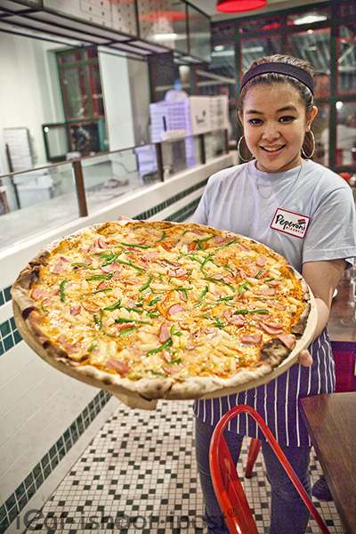
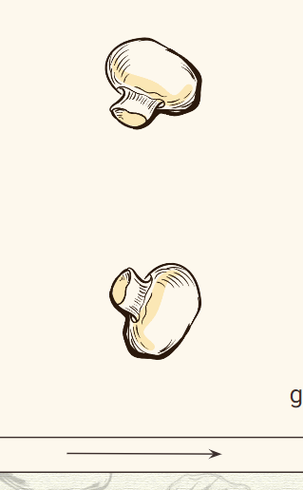
THE GREEK PIZZA
PREMIUM OFFERING: HIGHEST PRICED PIZZA
SIZE: XXL
Price: $35.95 is the most expensive item on the menu.
SELECT pt.name, p.size, p.price FROM pizzas p JOIN pizza_types pt ON p.pizza_type_id = pt.pizza_type_id ORDER BY p.price DESC LIMIT 1;

Slide 19
PRICE RANGE OF EACH CATEGORY
SELECT pt.category, MIN(p.price) as min_price, MAX(p.price) as max_price FROM pizzas p JOIN pizza_types pt ON p.pizza_type_id = pt.pizza_type_id GROUP BY pt.category;
‘Classic’ has the widest price range, indicating diverse offerings from basic to premium.
‘Chicken’ has the narrowest range but the highest minimum price, suggesting consistently premium positioning.

Slide 20
05
CATEGORY OVERVIEW
Segment-wise Performance

Slide 21

CATEGORY: TYPES VS REVENUE
SELECT category, COUNT(*) AS types_of_pizza FROM pizzas p JOIN pizza_types pt ON p.pizza_type_id = pt.pizza_type_id GROUP BY pt.category ORDER BY types_of_pizza DESC;
SELECT pt.category, SUM(od.quantity * p.price) AS total_revenue FROM order_details od JOIN pizzas p ON od.pizza_id = p.pizza_id JOIN pizza_types pt ON p.pizza_type_id = pt.pizza_type_id GROUP BY pt.category ORDER BY total_revenue DESC;

Slide 22
ORDER VOLUME IN EACH CATEGORY
SELECT pt.category, SUM(od.quantity) AS total_quantity FROM order_details od JOIN pizzas p ON od.pizza_id = p.pizza_id JOIN pizza_types pt ON p.pizza_type_id = pt.pizza_type_id GROUP BY pt.category ORDER BY total_quantity DESC;
Classic category leads in order quantity.

Slide 23
INSIGHTS AND RECOMMENDATIONS
Sales Patterns: Friday is the busiest day, while Sundays are slowest. Optimize staffing and inventory for peak Friday sales. Consider promotions for slower days.
Pricing Strategy: Wide price range in Classic category; narrow but higher range for Chicken. Consider premium pricing for popular Classic pizzas. Maintain premium positioning of Chicken pizzas.
Size Preferences: Large size is most popular across categories. Ensure adequate inventory for Large pizzas.

Slide 24
INSIGHTS AND RECOMMENDATIONS
Menu Efficiency: Chicken category has fewer types but high revenue per item. Explore introducing new Chicken pizza varieties.
Category Performance: Veggie category has most types (27) but lowest revenue. Assess Veggie pizza pricing and promotion strategies.
Product Mix: Classic category leads in orders, but Chicken pizzas are top revenue generators. Promote high-revenue Chicken pizzas more prominently. Evaluate underperforming Classic pizzas for potential menu optimization.

